Slide 1
Heart Attack Analysis & prediction Project
Author: Jaeha Huh

Slide 2
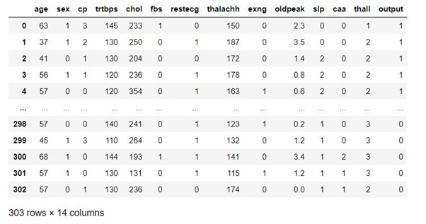
Dataset

Slide 3
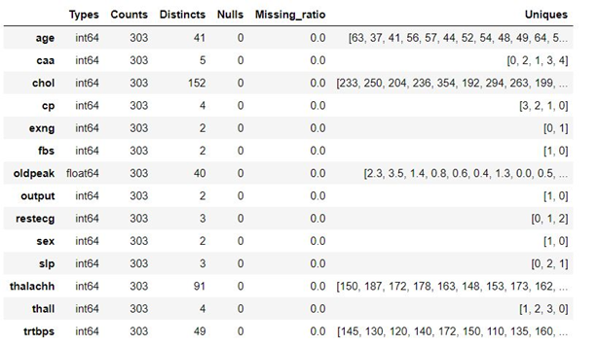
General information

Slide 4
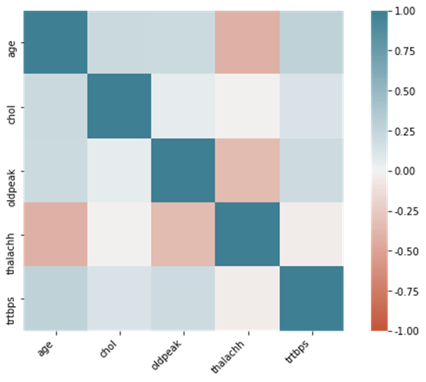
Correlation visualization

Slide 5
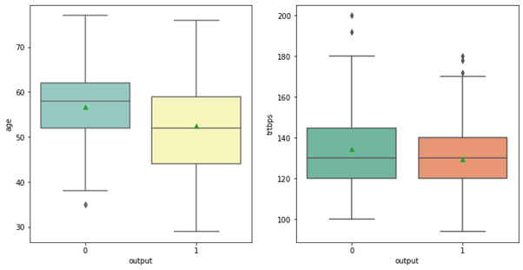
Relationship between age and heart attack; between tribps and heart attack

Slide 6
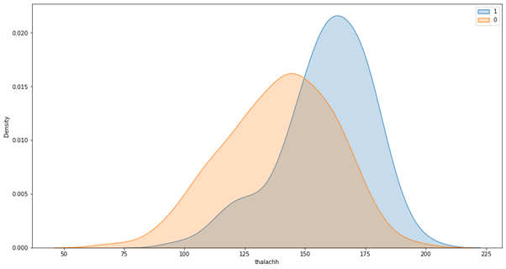
Relationship between theachh and heart attack

Slide 7
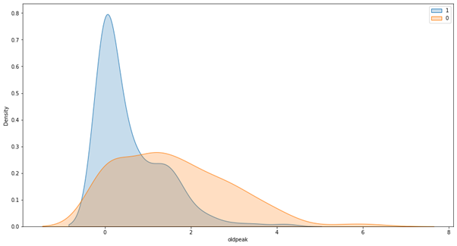
Relationship between old peak and heart attack

Slide 8
Modeling
Logistic Regression
SVM
Neural Networks

Slide 9
Logistic regression
K-fold Cross Validation
Hyper-parameter Tuning
C = 0.1, 0.5, 1, 3, 5

Slide 10
SVM
K-fold Cross Validation
Hyper-parameter Tuning
Kernal : linear, polynomial, rbf, sigmoid

Slide 11
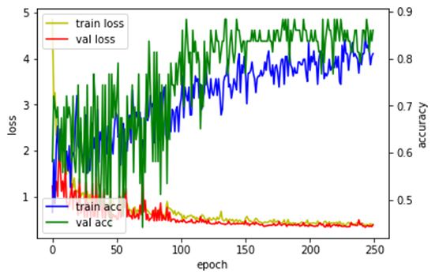
Neural Networks

Slide 12
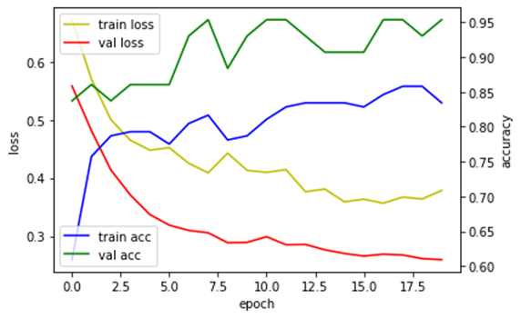
Neural Networks

Slide 13
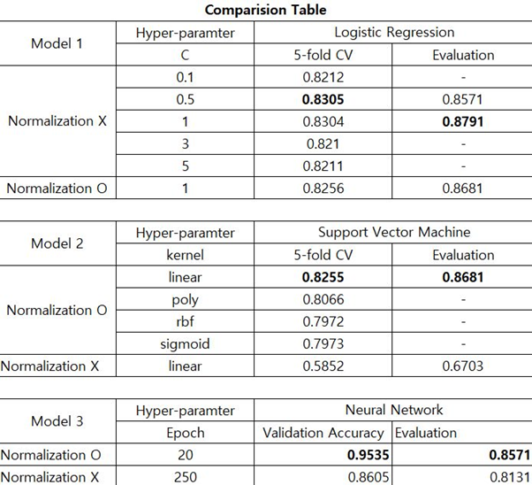
Comparison Table

